Slide 1
CORRELATION ANALYSIS

Slide 2
In our daily life - we use some yardstick to determine weight, height, or some other feature of a physical object.
We also measure when we judge how well we like a song, a painting or the personalities of our friends.
We, thus, measure physical objects as well as abstract concepts.
The most widely used classification of measurement scales are: (a) nominal scale; (b) ordinal scale; (c) interval scale; and (d) ratio scale.

Slide 3
MEASUREMENT SCALES
The most widely used classification of measurement scales are: (a) nominal scale; (b) ordinal scale; (c) interval scale; and (d) ratio scale.
Nominal scale:
the nominal scale allows us to qualitatively distinguish groups by categorizing them.
Nominal scale is simply a system of assigning number symbols to events in order to label them.
The usual example of this is the assignment of numbers of basketball players in order to identify them.
Such numbers cannot be considered to be associated with any ordered scale;
the numbers are just convenient labels for the particular class of events and as such have no quantitative value or resemblance.
Nominal scales provide convenient ways of keeping track of people, objects and events. (it can be names as well)
Ex: nominal → the country of origin of a product (named categories)

Slide 4
(b) Ordinal scale:
In ordinal scaling the numerical values are categorized to denote qualitative differences among the various categories.
they are rank-ordered in some meaningful way according to some preference.
The preferences would be ranked from best to worst, first to last, numbered 1, 2, and so on.
Oridinal scale is usually used to rate the preference or usage of various brands of a product by individuals.
Ordinal scales only permit the ranking of items from highest to lowest
Since the numbers of this scale have only a rank meaning, the appropriate measure of central tendency is the median.
Ex: ordinal → High Income group, middle income group, low income group (ordered categories: ranked according to order)

Slide 5
(c) Interval scale: the interval scale
classify individuals according to certain categories
determines order of these categories;
it also measure the magnitude of the differences in the preferences among the individuals.
the interval scale allows us to compute the mean and the standard deviation of the responses on the variables.
In interval measurement the distance between attributes does have meaning.
For example, when we measure temperature (in Fahrenheit), the distance from 30–40 is same as distance from 70–80. The interval values in interpretable.
the intervals are adjusted in terms of some rule
It also incorporates the concept of equality of interval
Ex: Interval → the number of times an individual makes a complaint (occurrence)
Interval scales provide more powerful measurement than ordinal scales, interval scale

Slide 6
(d) Ratio scale:
The ratio scale has an absolute measurement point. Thus the ratio scale not only measures the magnitude of the differences between points on the scale but also provides the proportions in the differences.
It is the most powerful of the four scales because it has a unique zero origin
Ex of ratio scale → the grades of test
Measures of physical dimensions such as weight
Generally, all statistical techniques are usable with ratio scales

Slide 7
INTRODUCTION
The statistical methods, discussed so far that is mean, median mode and SD, are used to analyse the data involving only one variable.
Often an analysis of data concerning two or more quantitative variables are needed to look for any statistical relationship or association between them.
Few instances where the knowledge of an association or relationship between two variables would prove vital - to make certain decision. Like:
Family income and expenditure on luxury items.
Yield of a crop and quantity of fertilizer used.
Sales revenue and expenses incurred on advertising.
Frequency of smoking and lung damage.
A statistical technique that is used to analyze the strength and direction of the relationship between two quantitative variables, is called correlation analysis

Slide 8
The coefficient of correlation, is a number that indicates the strength (magnitude) and direction of statistical relationship between two variables.
The importance of examining the statistical relationship between two or more variables answer these questions:
1. Is there an association between two or more variables? If yes, what is form and degree of that relationship?
2. Is the relationship strong or significant enough to be useful to arrive at a desirable conclusion?
3. Can the relationship be used for predictive purposes, that is, to predict the most likely value of a dependent variable corresponding to the given value of independent variable or variables?

Slide 9
SIGNIFICANCE OF MEASURING CORRELATION
The objective of any scientific and clinical research is to establish relationships between two or more sets of observations or variables to arrive at some conclusion which is also near to reality.
Finding such relationships is often an initial step for identifying causal relationships.

Slide 10
TYPES OF CORRELATIONS
There are three broad types of correlations:
1. Positive and negative,
2. Linear and non-linear,
3. Simple, partial, and multiple.
Positive and Negative Correlation
A positive (or direct) correlation refers to the same direction of change in the values of variables. In other words, if values of variables are varying (i.e., increasing or decreasing) in the same direction, then such correlation is referred to as positive correlation.
A negative (or inverse) correlation refers to the change in the values of variables in opposite direction.

Slide 11
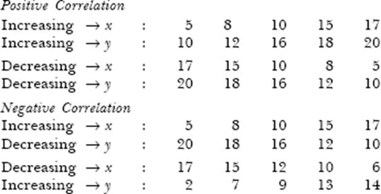

Slide 12

Linear and Non-Linear Correlation
A linear correlation implies a constant change in one of the variable values with respect to a change in the corresponding values of another variable.
In other words, a correlation is referred to as linear when variations in the values of two variables have a constant ratio.
The following example illustrates a linear correlation between two variables x and y.

Slide 13
A correlation is referred to as a non-linear correlation when the amount of change in the values of one variable does not bear a constant ratio to the amount of change in the corresponding values of another variable.
The following example illustrates a non-linear correlation between two variables x and y.
When these pair of values of x and y are plotted on a graph paper, the line joining these points would not be a straight line, rather it would be curvi-linear.

Slide 14
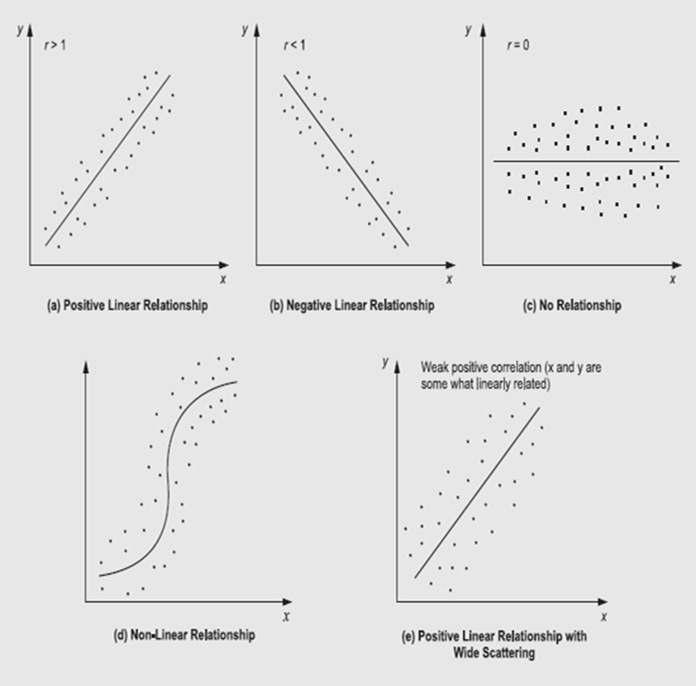

Slide 15
Simple, Partial, and Multiple Correlation
The distinction between simple, partial, and multiple correlation is based upon the number of variables involved in the correlation analysis.
simple correlation If only two variables are chosen to study correlation between them, then such a correlation is referred to as simple correlation.
EX: A study on the yield of a crop with respect to only amount of fertilizer,
EX: sales revenue with respect to amount of money spent on advertisement

Slide 16
In partial correlation, two variables are chosen to study the correlation - between them, but the effect of other influencing variables is kept constant.
For example
yield of a crop is influenced by the amount of fertilizer applied, rainfall, quality of seed, type of soil, and pesticides,
In such cases an attempt to measure the correlation between yield and seed quality, assuming that the average values of other factors exist, becomes a problem of partial correlation.

Slide 17
In multiple correlation, the relationship between more than three variables is considered simultaneously for study.
For example, employer-employee relationship in any organization may be examined with reference to, training and development facilities; medical, housing, and education to children facilities; salary structure; grievances handling system; and so on.

Slide 18
METHODS OF CORRELATION ANALYSIS
The correlation between two ratio-scaled (numeric) variables is represented by the letter ‘r’ which takes on values between –1 and +1 only. Sometimes this measure is called the ‘Pearson product moment correction’ or the correlation coefficient.
the following methods of finding the correlation coefficient between two variables x and y are discussed:
Scatter Diagram method
Karl Pearson's Coefficient of Correlation method
Spearman's Rank Correlation method

Slide 19
SCATTER DIAGRAM METHOD
The scatter diagram method is a quick at-a-glance method of determining of an apparent relationship between two variables, if any.
Apparent = Not certain whether it is true
A scatter diagram (or a graph) can be obtained on a graph paper
Plotting observed (or known) pairs of values of variables x and y scaled in units corresponding to the variables x and y
taking the independent variable values on the x-axis and the dependent variable values on the y-axis.

Slide 20
to indicate a visual display of the pattern of their relationship.
try to draw a straight line through data points so that an equal number of points lie on either side of the line.
The relationship between two variables x and y described by the data points is defined by this straight line.

Slide 21
Example Scatter: Given the following data:
Draw this data on a graph paper.
Grade Points depends upon Aptitude therefore
Aptitude is Independent Variable
Grade Points are dependent variable

Slide 22
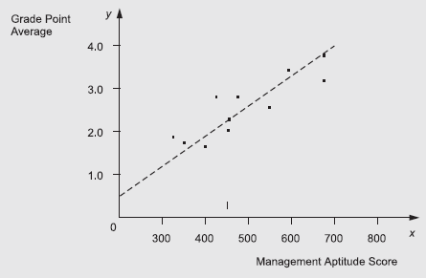
Solution: By taking an appropriate scale on the x and y axes, the pair of observations are plotted on a graph paper as shown in Fig. The scatter diagram in Fig. with straight line represents the relationship between x and y ‘fitted’ through it. (your grade point depends upon aptitude score)

Slide 23
Interpretation: From the scatter diagram shown in Fig. it appears that there is a high degree of association between two variable values.
It is because the data points are very close to a straight line passing through the points.
This pattern of dotted points also indicates a high degree of linear positive correlation.

Slide 24
KARL PEARSON'S CORRELATION COEFFICIENT
Karl Pearson's correlation coefficient measures quantitatively the extent to which two variables x and y are correlated.
Assumptions of Using Pearson's Correlation Coefficient
Pearson's correlation coefficient is appropriate to calculate when both variables x and y are measured on an interval or a ratio scale.
Both variables x and y are normally distributed, and that there is a linear relationship between these variables.

Slide 25
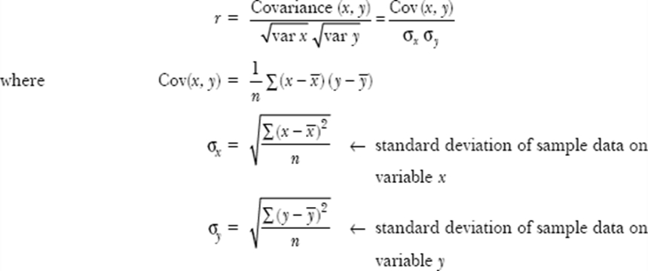
For a set of n pairs of values of x and y, Pearson's correlation coefficient r is given by DIRECT METHOD
Substituting mathematical formula for Cov (x, y) and σx and σy, we have

Slide 27
Ex: Calculate the product movement co-efficient of correlation between the following marks in Statistic's and Maths statistics: 4 7 8 3 4 Maths : 5 8 6 3 5 (direct method) soln: r = 0.799
X | Y | XY | X² | Y²
04 | 05 | 20 | 16 | 25
07 | 08 | 56 | 49 | 64
08 | 06 | 48 | 64 | 36
03 | 03 | 09 | 09 | 09
04 | 05 | 20 | 16 | 25
∑X = 26 | ∑Y = 27 | ∑XY = 153 | ∑X² = 154 | ∑Y² = 159

Slide 28
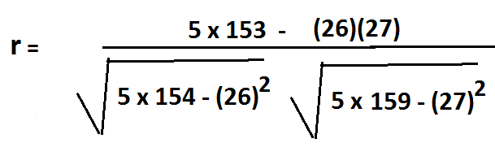
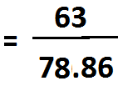
Interpretation:
Since coefficient of correlation r = +0.799, it indicates that there is a high degree of POSITIVE correlation between the two variables.
Hence we conclude that as the marks in statistics increased, the marks in maths also increased positively.

Slide 29
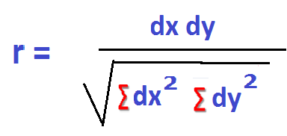
KARL PEARSON'S CORRELATION COEFFICIENT
DIRECT METHOD

Slide 30
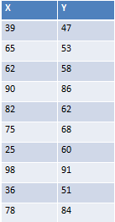
Problem: Calculate Karl PEARSONS’S coefficient of correlation between expenditure on advertising from the given data (direct method)

Slide 31










DIRECT METHOD WITH TRUE MEAN WHEN NUMERICALS ARE BIG
X | Y
39 | 47 | - 26 | - 19 | 676 | 361 | 494
65 | 53 | 0 | - 13 | 0 | 169 | 0
62 | 58 | - 3 | - 8 | 9 | 64 | 24
90 | 86 | 25 | 20 | 625 | 400 | 500
82 | 62 | 17 | - 4 | 289 | 16 | - 68
75 | 68 | 10 | 2 | 100 | 4 | 20
25 | 60 | - 40 | - 6 | 1600 | 36 | 240
98 | 91 | 33 | 25 | 1089 | 625 | 825
36 | 51 | -29 | - 15 | 841 | 225 | 435
78 | 84 | 13 | 16 | 169 | 324 | 234

Slide 32
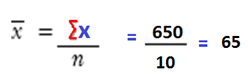

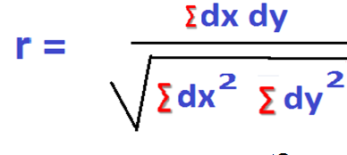
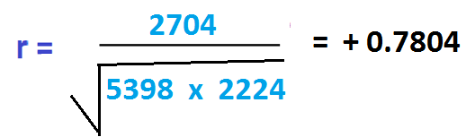
Interpretation:
Since coefficient of correlation r = +0.7804, it indicates that there is a high degree of POSITIVE correlation between the two variables.
Hence we conclude that sales have increased, with an increased in advertising expenditure.

Slide 33
ASSUMED MEAN METHOD
formula
The calculation of Pearson's correlation coefficient can be simplified by taking deviations of x and y values from their assumed means A and B, respectively.
That is, dx = x – A and dy = y – B, where A and B are assumed means of x and y values

Slide 34
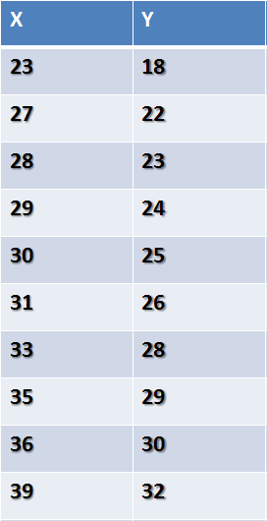
Problem: Calculate Karl PEARSONS’S coefficient of correlation for the ages of husbands and wives

Slide 35









ASSUMED MEAN KARL-PEARSONS’
X | Y
23 | 18 | - 8 | - 7 | 64 | 49 | 56
27 | 22 | - 4 | - 3 | 16 | 9 | 12
28 | 23 | - 3 | - 2 | 9 | 4 | 6
29 | 24 | - 2 | - 1 | 4 | 1 | 2
30 | 25 → Am | - 1 | 0 | 1 | 0 | 0
31 → Am | 26 | 0 | 1 | 0 | 1 | 0
33 | 28 | 2 | 3 | 4 | 9 | 6
35 | 29 | 4 | 4 | 16 | 16 | 16
36 | 30 | 5 | 5 | 25 | 25 | 25
39 | 32 | 8 | 7 | 64 | 49 | 56

Slide 36
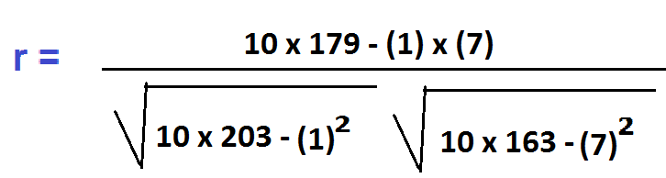

Interpretation:
Since coefficient of correlation r = +0.9956, it indicates that there is a high degree of POSITIVE correlation (almost perfect) with the value of r approaching + 1.
Hence we conclude as Husbands age increased (decreased), wives age also increased (decreased).

Slide 37
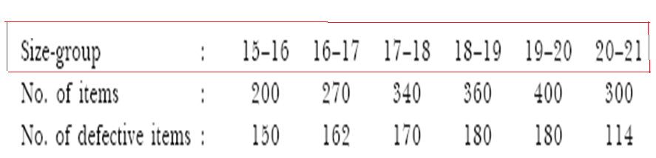
Example : The following table gives the distribution of items of production and also the relatively defective items among them, according to size groups. Find the correlation coefficient between size and defect in quality.
Solution: Let group size be denoted by variable x and number of defective items by variable y. Calculations for Karl Pearson's correlation coefficient are shown below:

Slide 38
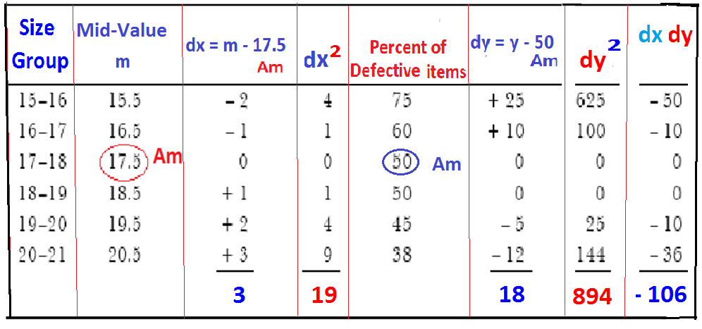
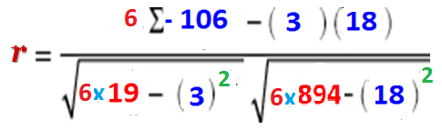

Solution: Let group size be denoted by variable x and number of defective items by variable y. Calculations for Karl Pearson's correlation coefficient are shown below:

Slide 39
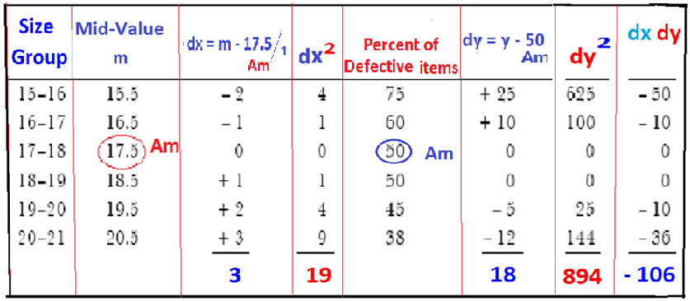

Slide 40

Substituting values in the formula of Karl Pearson's correlation coefficient r, we have
Interpretation: Since value of r is negative, and is close to –1, statistical association between x (size group) and y (percent of defective items) is highly negative, we conclude that when size of group increases, the number of defective items decreases and vice-versa.

Slide 41
SPEARMAN'S RANK CORRELATION COEFFICIENT
This method of finding the correlation coefficient between two variables was developed by the British psychologist Charles Edward Spearman in 1904.
This method is applied to measure the association between two variables when only ordinal (or rank) data are available.
The ranking is decided by using a set of ordinal rank numbers, with 1 for the individual observation ranked first either in terms of quantity or quality;
n for the individual observation ranked last in a group. Mathematically, Spearman's rank correlation coefficient is defined as:
The number ‘6’ is placed in the formula as a scaling device, it ensures that the possible range of R is from – 1 to 1.

Slide 42
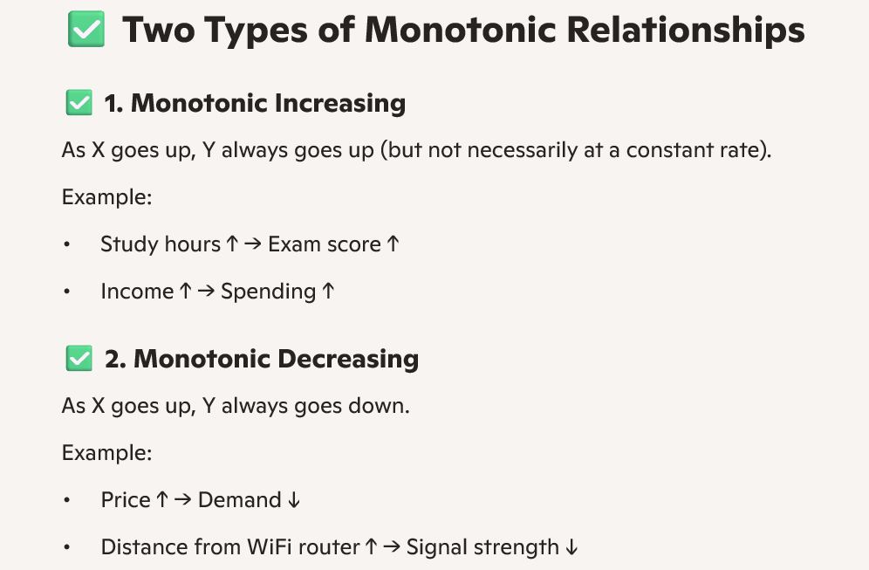
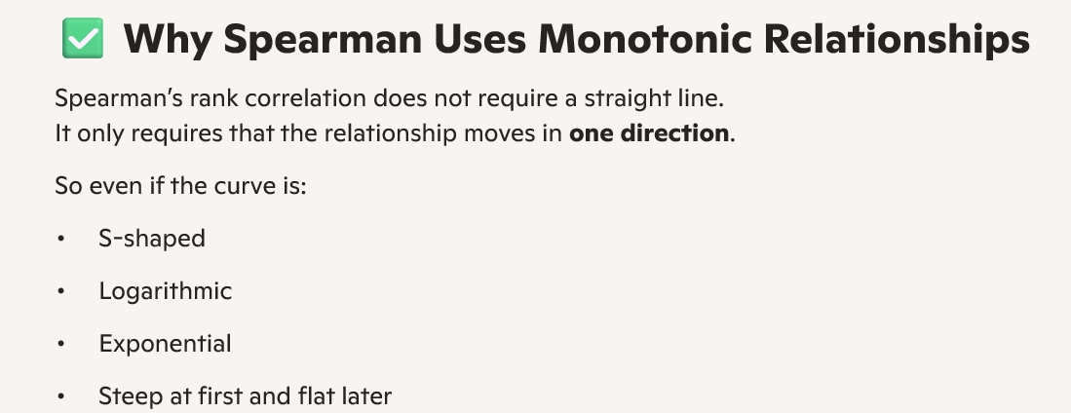
A monotonic relationship means the variables move in a single consistent direction, even if the relationship is curved, uneven, or non-linear.
A monotonic relationship is one where the direction of the relationship between two variables is consistent, even if the rate of change is not.

Slide 43
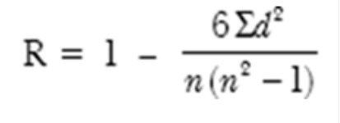

Slide 44
Advantages of spearman's correlation coefficient method
1. this method is easy to understand and its application is simpler than Pearson's method.
2. this method is useful for correlation analysis when variables are expressed in qualitative terms like beauty, intelligence, honesty, efficiency, and so on.
3. this method is appropriate to measure the association between two variables if the data type is at least ordinal scaled (ranked)
4. the sample data of values of two variables is converted into ranks either in ascending order or descending order for calculating degree of correlation between two variables.
disadvantages
1. values of both variables are assumed to be normally distributed and describing a linear relationship rather than non-linear relationship.
2. a large computational time is required when number of pairs of values of two variables exceed 30.
3. this method cannot be applied to measure the association between two variable grouped data.

Slide 45
Example: The ranks of 15 students in two subjects A and B, are given below. The two numbers within brackets denote the ranks of a student in A and B subjects respectively. (note: ranks are not repeated)
Find Spearman's rank correlation coefficient

Slide 46
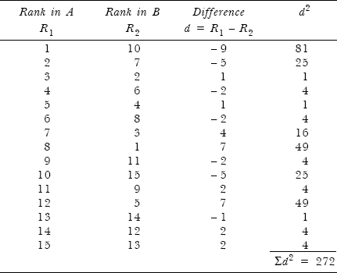
Solution: Since ranks of students with respect to their performance in two subjects are given, calculations for rank correlation coefficient are:
The result shows a moderate degree positive correlation between performance of students in two subjects.

Slide 48

Example : Ten competitors in a beauty contest are ranked by three judges in the following order:
Use the rank correlation coefficient to determine which pair of judges has the nearest approach to common tastes in beauty.

Slide 49
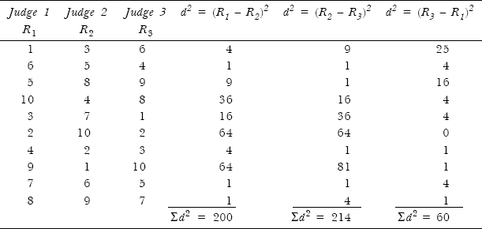
Solution: The pair of judges who have the nearest approach to common taste in beauty can be obtained in 3C₂ = 3 ways as follows:
1. Judge 1 and judge 2.
2. Judge 2 and judge 3.
3. Judge 3 and judge 1.

Slide 50
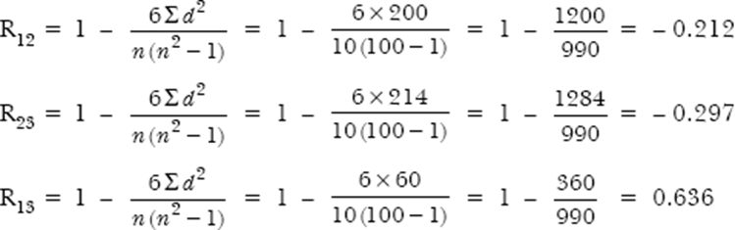
Applying the formula
Since the correlation coefficient R13 = 0.636 is largest, the judges 1 and 3 have nearest approach to common tastes in beauty.

Slide 51
EX: An economist wanted to find out if there was any relationship between the unemployment rate in a country and its inflation rate. Data gathered from 7 countries for the year 2004 are given below:
Find the degree of linear association between a country's unemployment rate and its level of inflation.
Country | Unemployment Rate (Percent) | Inflation Rate (Per cent)
A | 4.0 | 3.2
B | 8.5 | 8.2
C | 5.5 | 9.4
D | 0.8 | 5.1
E | 7.3 | 10.1
F | 5.8 | 7.8
G | 2.1 | 4.7

Slide 52
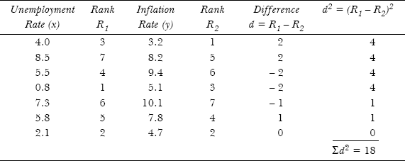

Solution: Let us start ranking from the lowest value for both the variables as shown below:
The result shows a moderately high degree of positive correlation between unemployment rate and inflation rate of seven countries.

Slide 53

WHEN RANKS ARE EQUAL
where m_{i} (i = 1, 2, 3,…) stands for the number of times an observation is repeated in the data set for both variables.
EX: Obtain the rank correlation coefficient between the variables x and y from the following pairs of observed values.

Slide 54
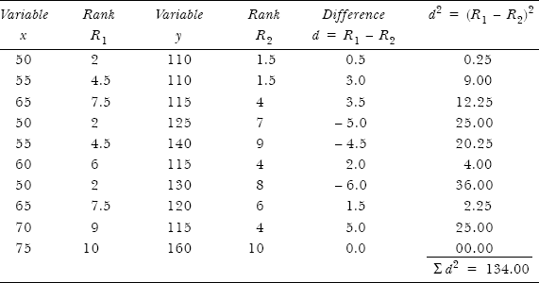
Solution: Let us start ranking from lowest value for both the variables. Moreover, certain observations in both sets of data are repeated,
Go with Lowest to give ranks, three observations are ranked equal in case above ‘x’ variable i.e., 50 which can be ranked as (1+2+3)/3 = 2 , then the average rank of 2 is assigned to these three observations. (3 ranks are exhausted i.e., 1,2,3)
Similarly, two observations are ranked equal at fourth place ‘x’ variable ‘55’, then the average rank of (4 + 5)/2 = 4.5 is assigned to these two observations. (2 ranks are exhausted i.e., 4,5)

Slide 55
6th place goes to Numerical 60 as it is single value
Similarly, two observations are ranked equal at 7th and 8th place ‘x’ variable ‘65’, then the average rank of (7 + 8)/2 = 7.5 is assigned to these two observations (2 ranks are exhausted i.e., 7, 8)
It may be noted that for variable x, 50 is repeated thrice (m₁ = 3), 55 is repeated twice (m₂ = 2), and 65 is repeated twice (m₃ = 2).
FOR VARIABLE ‘Y’ Go with Lowest to give ranks again
two observations are ranked equal in case above ‘y’ variable i.e., 110 which can be ranked as (1+2)/2 = 1.5 , then the average rank of 1.5 is assigned to these two observations. (2 ranks are exhausted i.e., 1,2)

Slide 56
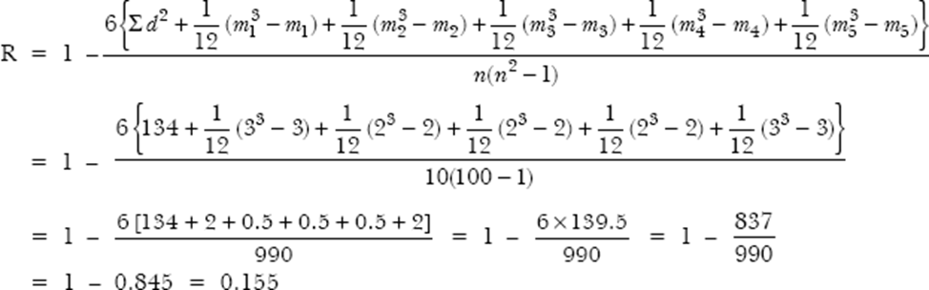
Similarly, three observations are ranked equal at 3rd 4th 5th place ‘y’ variable ‘115’, then the average rank of (3 + 4 + 5)/3 = 4 is assigned to these three observations (3 ranks are exhausted i.e., 3,4,5)
variable y, 110 is repeated twice (m₄= 2) and 115 thrice (m₅ = 3). Applying the formula:
The result shows a weak positive association between variables x ands y

Slide 57
Regression Analysis
In statistical modeling, regression analysis is a set of statistical processes for estimating the relationships between a dependent variable (often called the 'outcome variable') and one or more independent variables (often called 'predictor Variable)
The variable whose value is estimated using the algebraic equation is called dependent (or response) variable and the variable whose value is used to estimate this value is called independent (regressor or predictor) variable.
The term regression was used in 1877 by Sir Francis Galton while studying the relationship between the height of father and sons

Slide 58
The basic differences between correlation and regression analysis are summarized as follows:
  Developing an algebraic equation between two variables from sample data and predicting the value of one variable, given the value of the other variable is referred to as regression analysis,
while measuring the strength (or degree) of the relationship between two variables is referred as correlation analysis.
The sign of correlation coefficient indicates the nature (direct or inverse) of relationship between two variables, while the absolute value of correlation coefficient indicates the extent of relationship.

Slide 59
Correlation analysis determines an association between two variables x and y but not that they have a cause-and-effect relationship.
Regression analysis, in contrast, determines the cause-and-effect relationship between x and y, that is, a change in the value of independent variable x causes a corresponding change (effect) in the value of dependent variable y if all other factors that affect y remain unchanged.
3. In linear regression analysis one variable is considered as dependent variable and other as independent variable, while in correlation analysis both variables are considered to be independent.

Slide 60
Advantages of regression analysis:
Regression analysis helps in developing a regression equation by which the value of a dependent variable can be estimated given a value of an independent variable.
Regression analysis helps to determine standard error of estimate to measure the variability or spread of values of a dependent variable with respect to the regression line.
Smaller the variance and error of estimate, the closer the pair of values (x, y) fall about the regression line and better the line fits the data, that is, a good estimate can be made of the value of variable y. When all the points fall on the line, the standard error of estimate equals zero.

Slide 61
TYPES OF REGRESSION MODELS
The primary objective of regression analysis is the development of a regression model to explain the association between two or more variables in the given population.
A regression model is the mathematical equation that provides prediction of value of dependent variable based on the known values of one or more independent variables
SIMPLE LINEAR REGRESSION MODEL
The fundamental aim of regression analysis is to determine a regression equation (line) that makes sense and fits the representative data such that the error of variance is as small as possible.
J. R. Stockton stated that
The device used for estimating the values of one variable from the value of the other → consists of a line through the points, drawn in such a manner as to represent the average relationship between the two variables. Such a line is called line of regression.
The two variables x and y which are correlated can be expressed in terms of each other in the form of straight line equations called regression equations

Slide 62
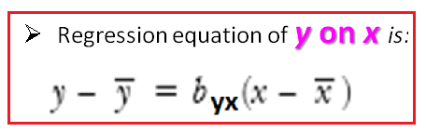
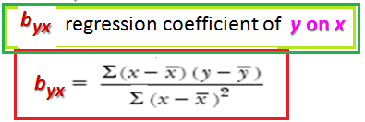
THE ALGEBRAIC EXPRESSION OF REGRESSION LINES IS WRITTEN AS
The regression equation of y on x is y = a + bx is used for estimating the value of y for given values of x.
b = slope of regression line that represents the expected change in the value of y for unit change in the value of x’
where

Slide 63
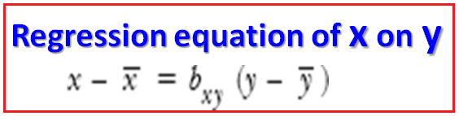
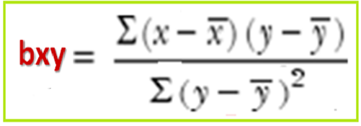
•
The value of bxy can be calculated formula

Slide 64
Exam: 14mba14 june-july 2015
The following data relate to the ages of Husbands and Wives. Find the regression equations and also find the most likely age of husband when wifes’ age is 25 years.
AGE OF HUSBANDS (Years) | AGE OF WIVES (Years)
25 | 20
28 | 26
30 | 29
32 | 30
35 | 25
36 | 18
38 | 26
39 | 35
42 | 35
55 | 46

Slide 65



Soln: Let age of Husband be ‘x’ and age of wife be ‘y’.
x | y | X - X̄ |  | Y - Ȳ
25 | 20 | -11 | 121 | -9 | 81 | 99
28 | 26 | -8 | 64 | -3 | 9 | 24
30 | 29 | -6 | 36 | 0 | 0 | 0
32 | 30 | -4 | 16 | 1 | 1 | -4
35 | 25 | -1 | 1 | 4 | 16 | 4
36 | 18 | 0 | 0 | -11 | 121 | 0
38 | 26 | 2 | 4 | -3 | 9 | -6
39 | 35 | 3 | 9 | 6 | 36 | 18
42 | 35 | 6 | 36 | 6 | 36 | 36
55 | 46 | 19 | 361 | 17 | 289 | 323
∑x= 360 | ∑y= 290 | ∑= 0 | ∑= 648 | ∑= 0 | ∑ = 598 | ∑= 494

Slide 66


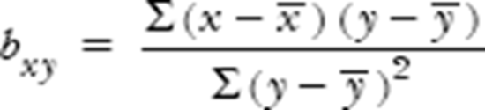
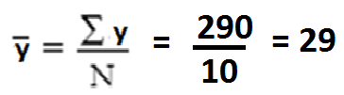
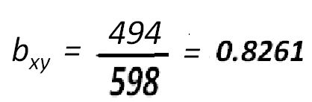
Regression equation of x on y is:
(x - 36) = 0.8261 (y - 29)
x = 12.0435 + 0.8261 y
we have denoted x as Husbands age and Y as wifes age:
Age of Husband (x) when wifes’ age is 25 (y) is given:
x = 12.0435 + 0.8261 y
x = 12.0435 + 0.8261 (25)
Age of Husband (x) = 32.69 when wifes age is 25 yrs.

Slide 67
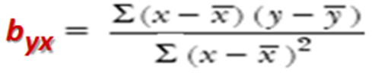
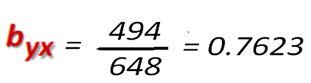
(y - 29) = 0.7623 (x - 36)
y = 1.526 + 0.7623x
Regression equation of y on x is:

Slide 68

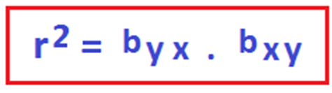
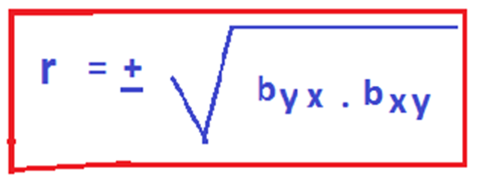

Slide 69
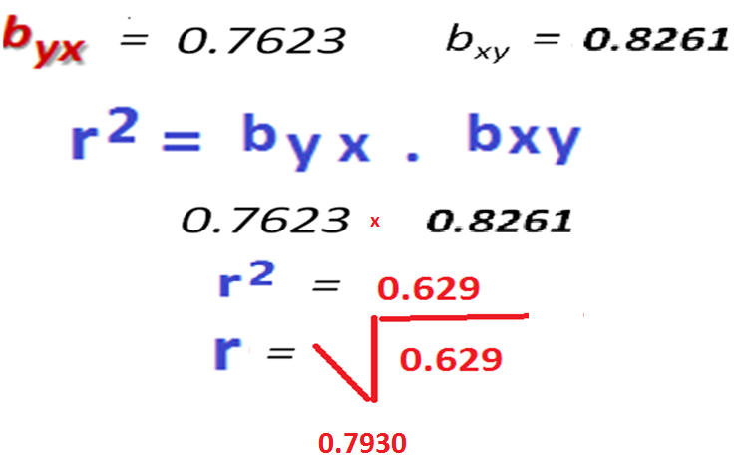

Slide 70
(a) Multiple regression analysis: This analysis is adopted when the researcher has one dependent variable which is presumed to be a function of two or more independent variables. The objective of this analysis is to make a prediction about the dependent variable based on its covariance with all the concerned independent variables.
Covariance is a measure of how changes in one variable are associated with changes in a second variable.

Slide 71
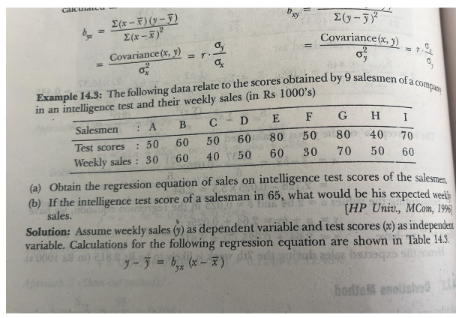

Slide 72
